Slide 1
SEARCH APPLICATION FOR TWITTER DATA
Jahnavi Shah
Keshvi Gupta
Amaan Vora
Atharva Sherekar

Slide 2
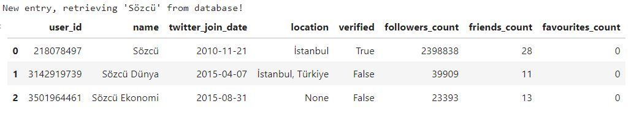
SCOPE OF SEARCH APPLICATION
User
Keyword
Hashtag
time_range
FEATURES
Most Engaging Tweets
Most Popular Users
Most Popular Hashtags
reply_count
quote_count
favourite_count
retweet_count
RELEVANCE
30%
30%
20%
20%
EXAMPLE

Slide 3
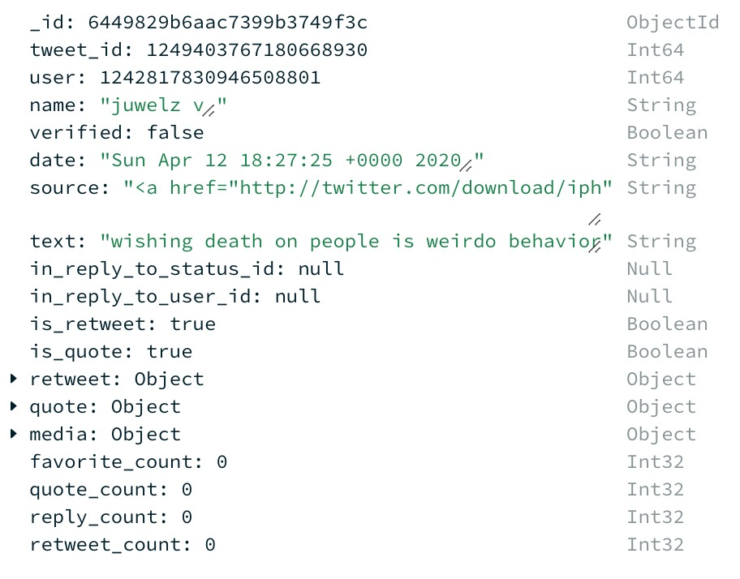
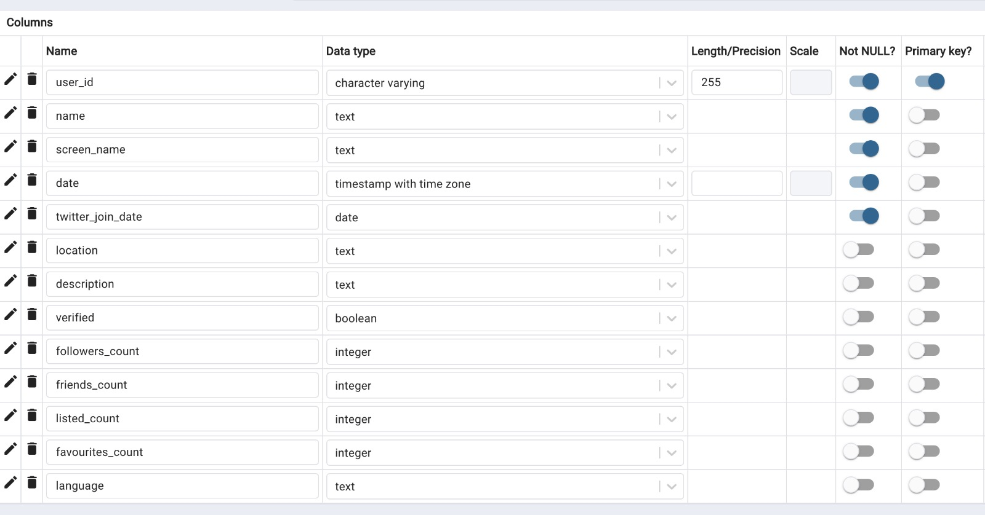
MONGODB
TWEETS DATA IS UNSTRUCTURED
POSTGRESQL
USERS
TWEETS
MongoDB allows for more flexible and scalable data storage, as it does not require a fixed schema and can handle large amounts of unstructured data. It would store the text of tweets, along with any associated media and would allow for efficient searching and retrieval of this data.
USERS DATA IS STRUCTURED
PostgreSQL is a popular choice for structured data storage in the Twitter search application due to its relational database management capabilities, ACID compliance, open source nature, and extensibility.
TWITTER DATA

Slide 4
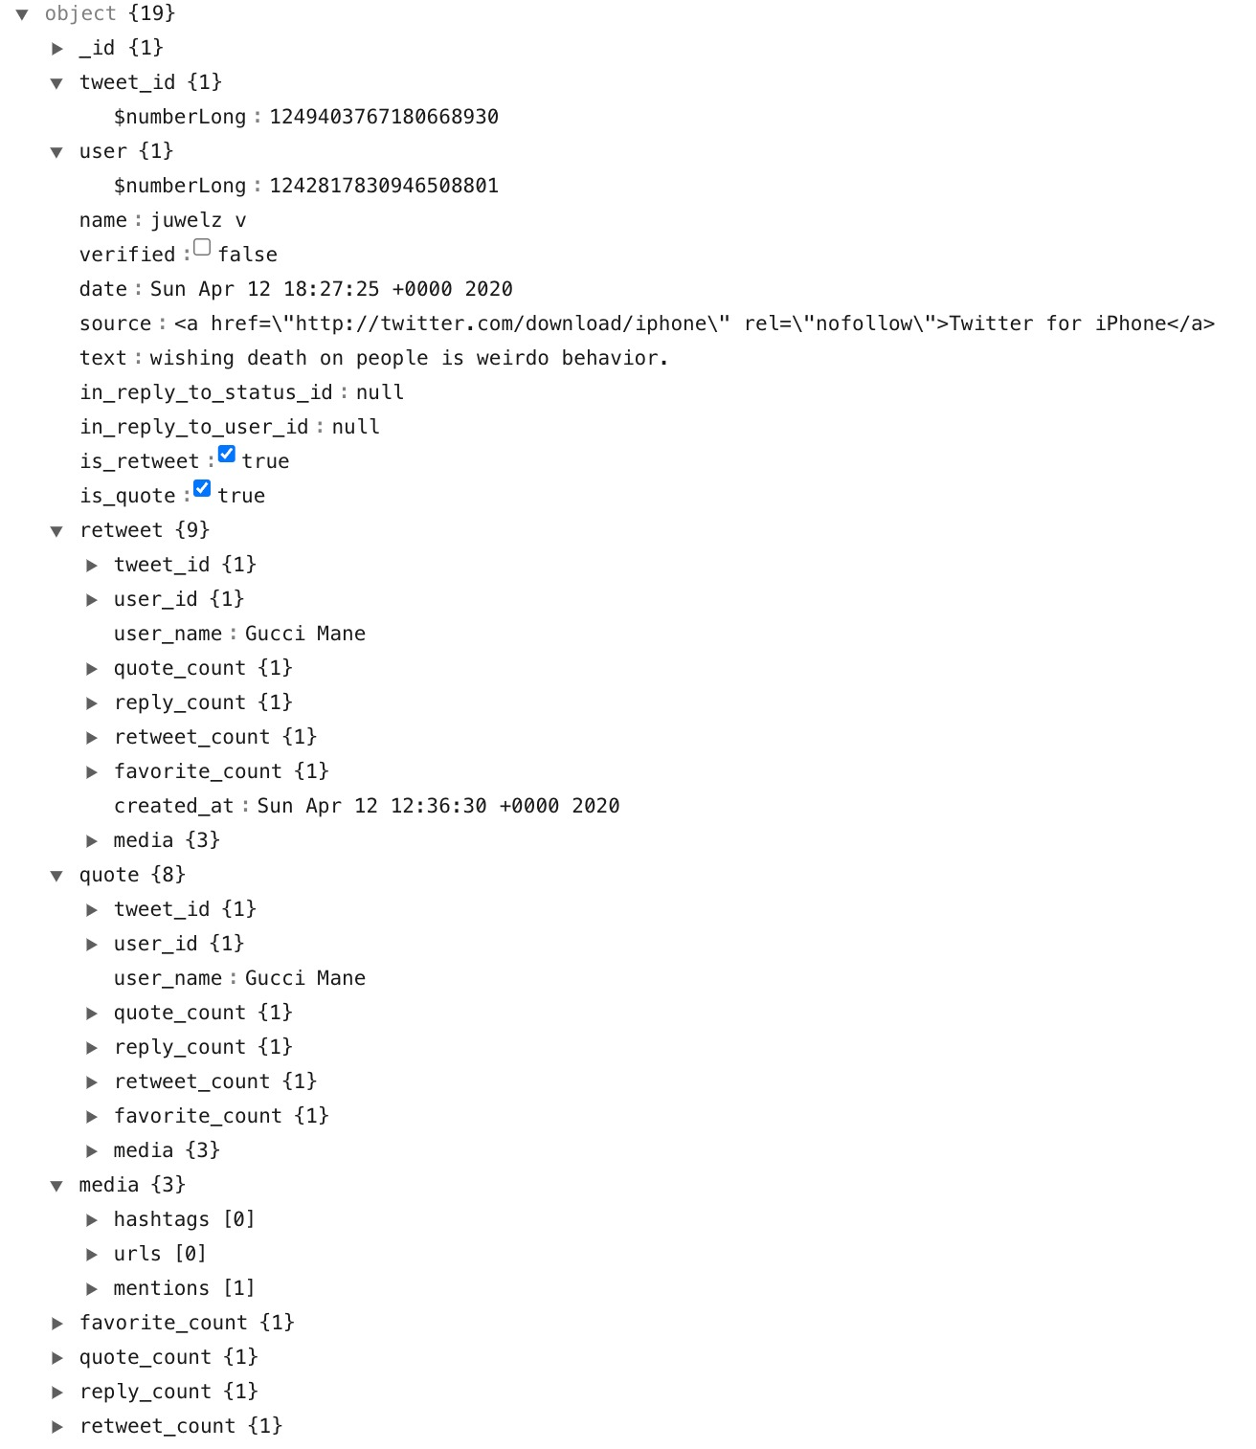
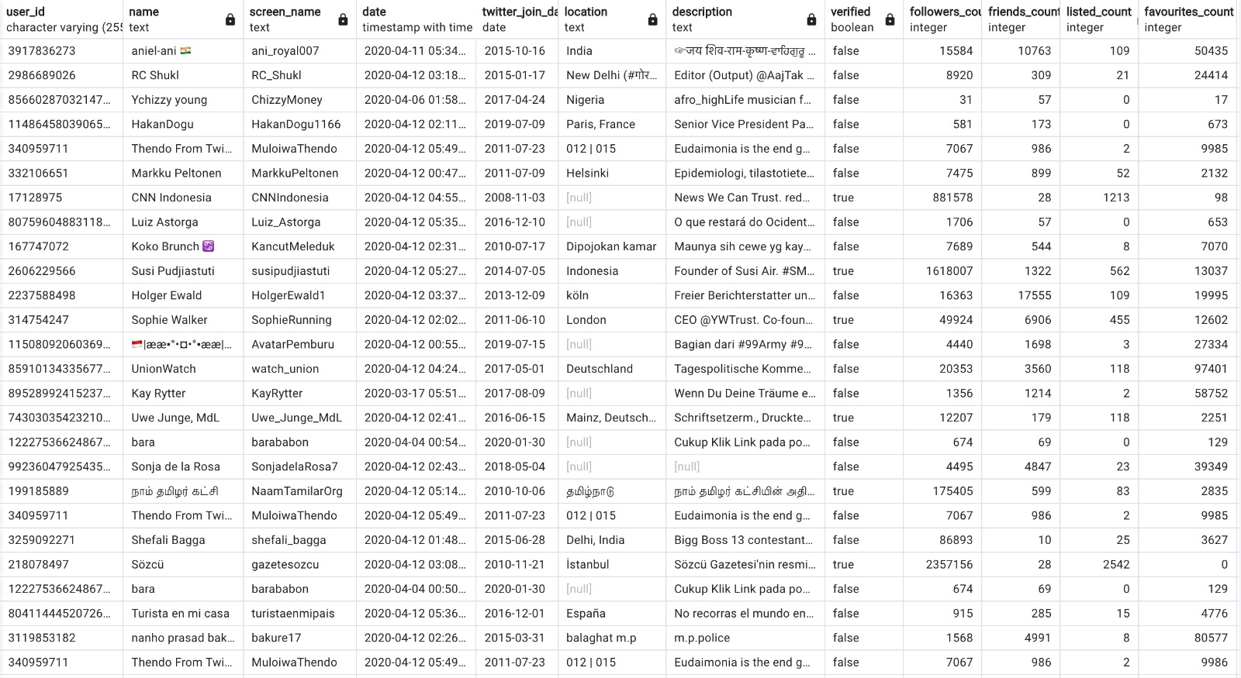
UNDERSTANDING DATA
Users
Tweets
Tweets
All the historical user information added is kept in the table
Most current entry is indicated by is_current indicator == 1
Fact Table
Dim Table

Slide 5
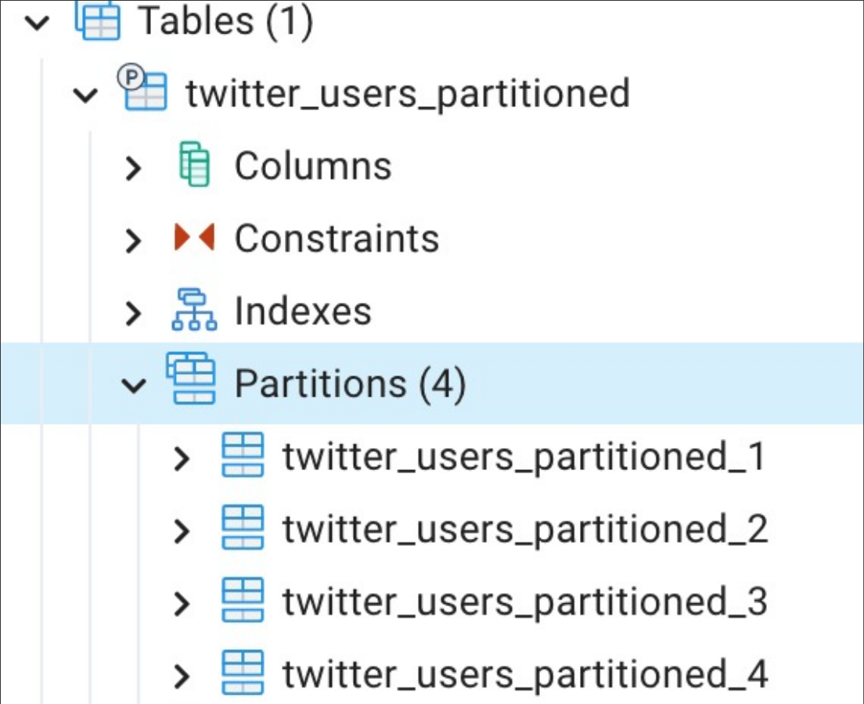
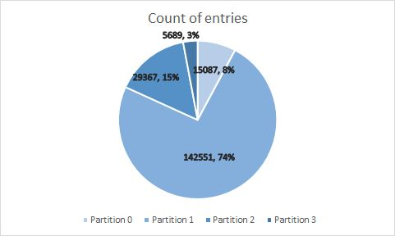
PARTITIONING
Technique used in distributed databases to divide large datasets into smaller, more manageable chunks.
Was done on the “created at” for a 6-hour basis to improve performance and scalability.
Used to improve query performance and reduce data processing time.
Partition 1
Partition 2
Partition 3
Partition 4
6 Hours
6 Hours
6 Hours
6 Hours

Slide 6
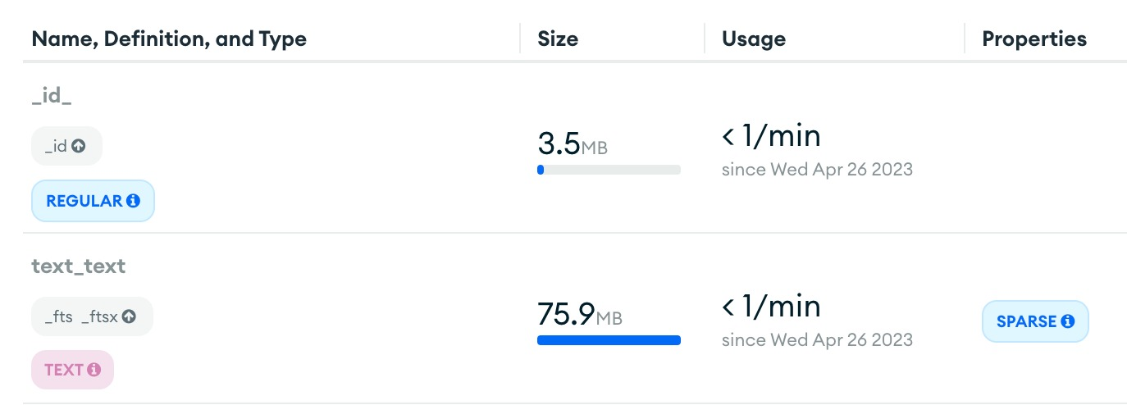
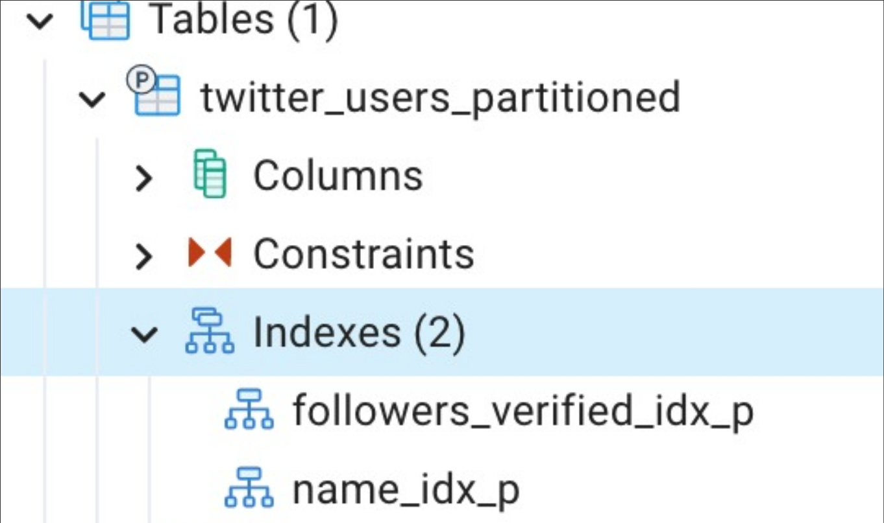
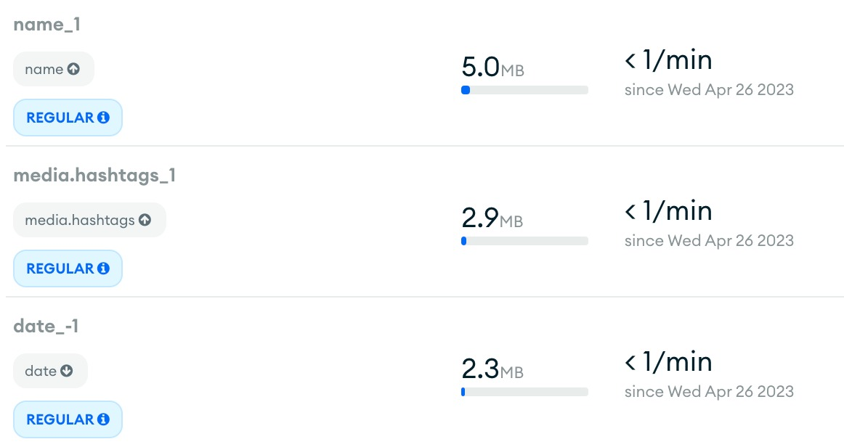
INDEXING
USERS
Efficient
sorting
TWEETS
Scalability
Name
Text
Followers count
Better query
performance
Name
Faster retrieval
Verified
Date
Reduced resource consumption
Better quality
performance

Slide 7


CACHING
What is
Caching?
What is LRU?
Advantages
Time To Live?
Improves the performance of applications that rely on retrieving data from Twitter's servers.
Caching algorithm used to remove the least recently used items from a cache.
Improves performance by storing frequently accessed Twitter data.
After the TTL period elapses, the cached data is considered invalid and must be refreshed from the source.
Fixed!
LRU
Latest Search Entry
Cache size
100
Most Engaging tweets
Most popular users
Most popular hastags
TTL
60 Sec!
Oldest Search Entry
Checkpoint!
2 mins

Slide 8
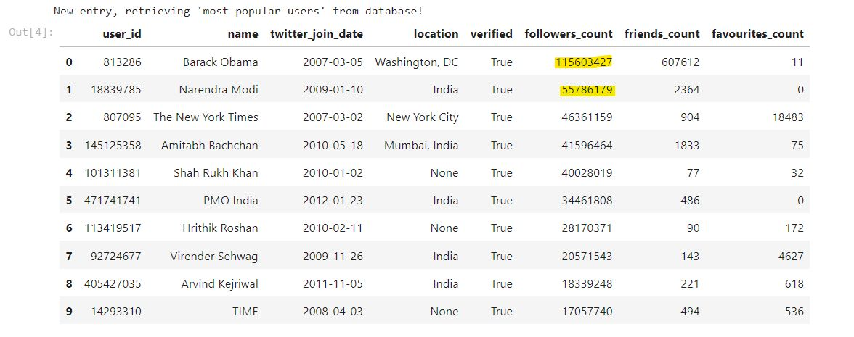
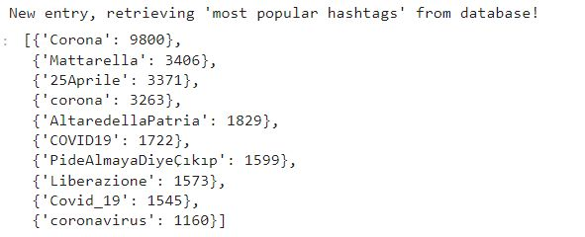
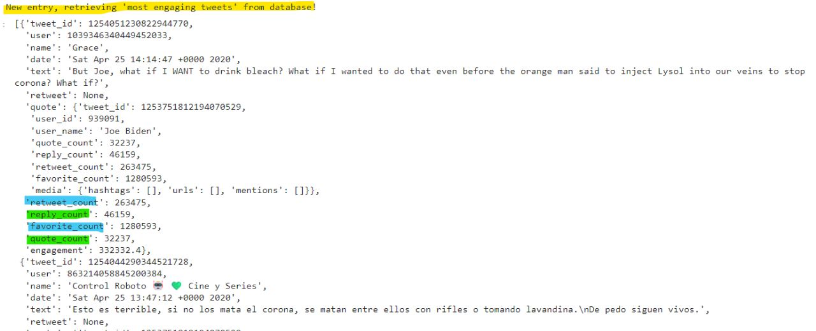
SEARCH APPLICATION
Most Popular Hashtags
Most Popular Users
Most Engaging Tweets

Slide 9
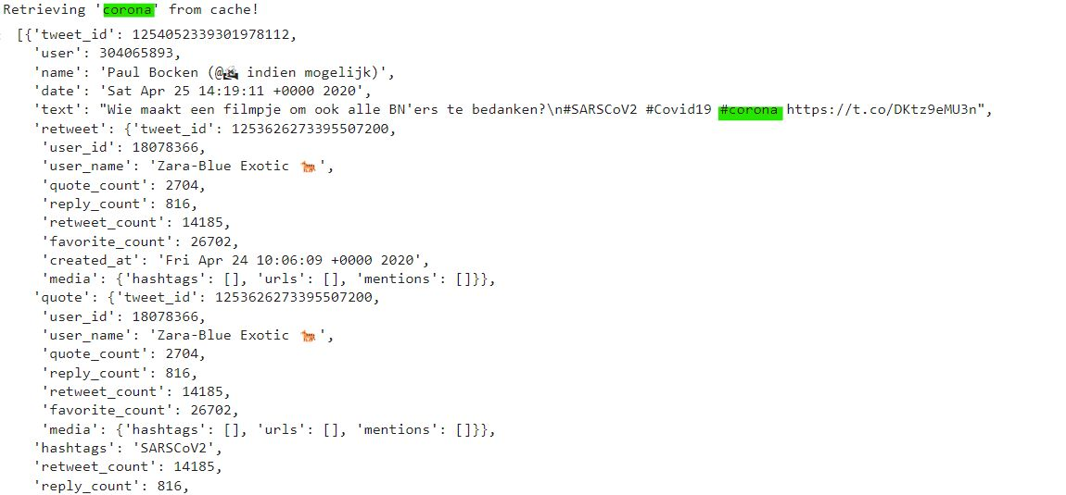
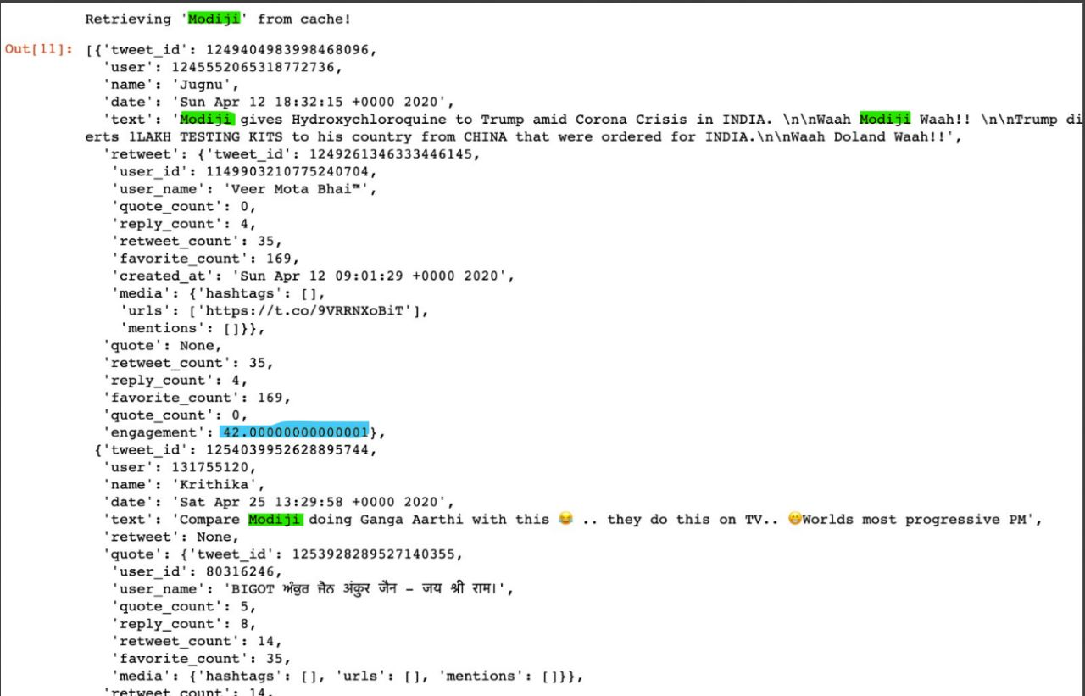
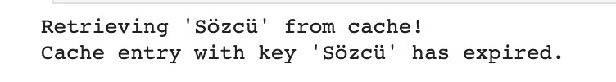
SEARCH APPLICATION – WITH CACHE
Query 1 – “corona”
Time To Live – Cache Expiry
Query 2 – “Modiji”

Slide 10
Thank You

